Slide 1
Interaction with Matter
P47 – Optics: Unit 2

Slide 2
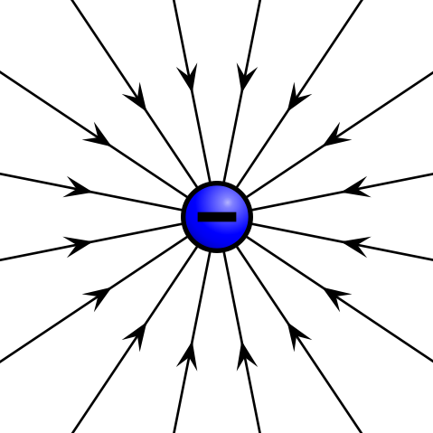
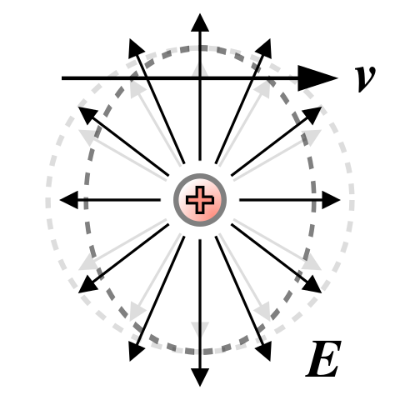
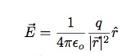
Unit 2
Electric Field of Point Charge
stationary
constant velocity

Slide 3
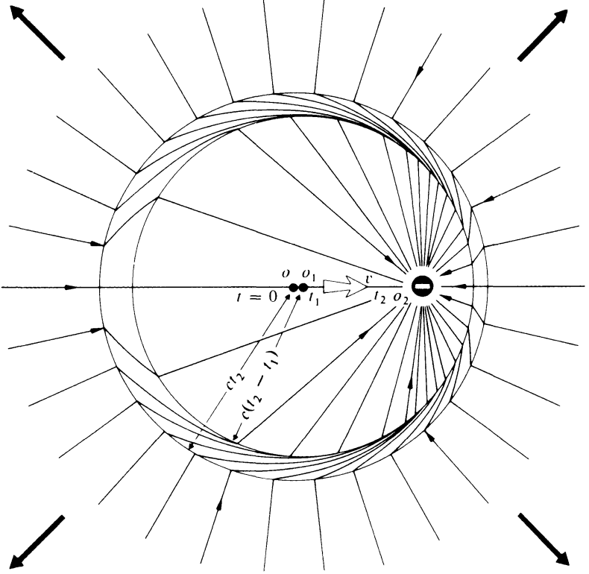
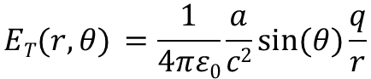
Unit 2
Accelerating charges radiate!
t = 0: stationary charge (E_{C} ~ 1/r²)
t = 0→t₁: constant acceleration
t = t₁→t₂: constant velocity
all field lines must be connected (Gauss’ Law)
produces transverse E-field components during acceleration
transverse components propagate outward (E_{T} ~ 1/r)
Why aren’t E-field lines at O₂ radially symmetric?
$$ET(r,θ) =\frac{1}{4πε0}\frac{a}{c2}sin⁡(θ)\frac{q}{r}$$

Slide 4
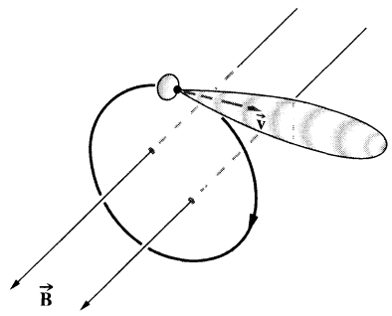
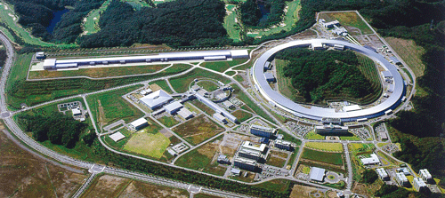
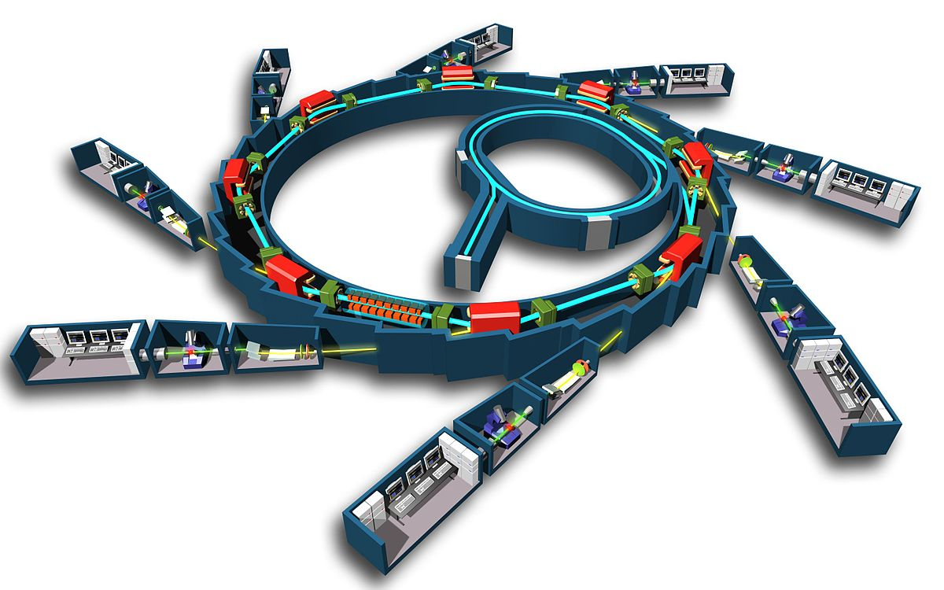
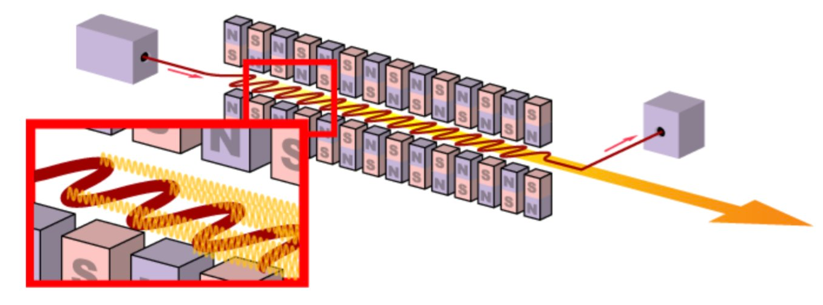
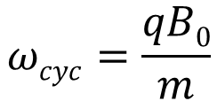
Unit 2
$$ωcyc=\frac{qB0}{m}$$
Spring-8 synchotron & SACLA free-electron laser - Japan

Slide 5
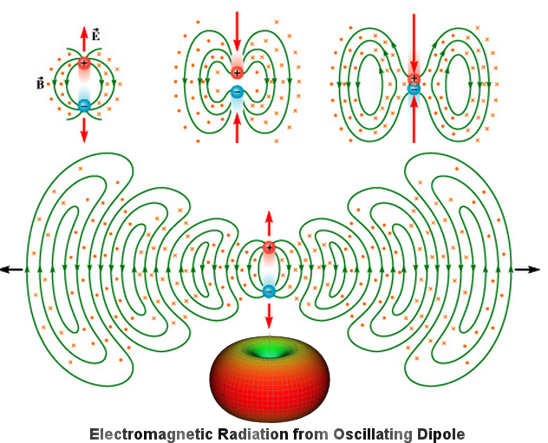
Unit 2
…but in optics, normally only have dipole radiation
[credit: universe-review.ca]

Slide 6
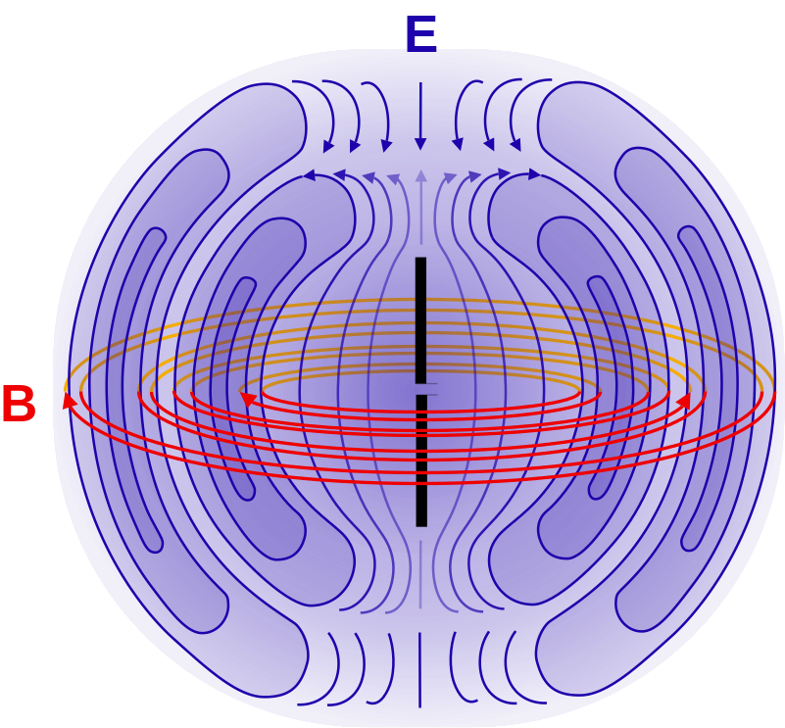
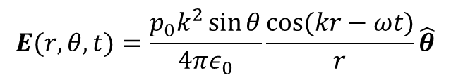
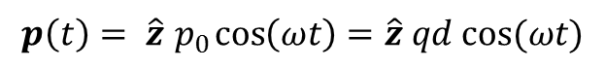
Unit 2
…but in optics, normally only have dipole radiation
$$p\left(t\right)= \hat{z}{ p}_{0}\cos\left(ωt\right)=\hat{z} qd cos⁡(ωt)$$
In the “far field” (r>>d) the radiated field is:
$$E(r,θ,t)=\frac{p_{0}k^{2}\sin{θ}}{4πε_{0}}\frac{cos⁡(kr−ωt)}{r}\hat{θ}$$
Radiation pattern of a
dipole antenna
Note: No radiation at θ=0. This will matter later!

Slide 7
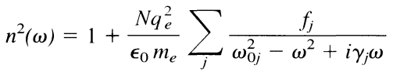
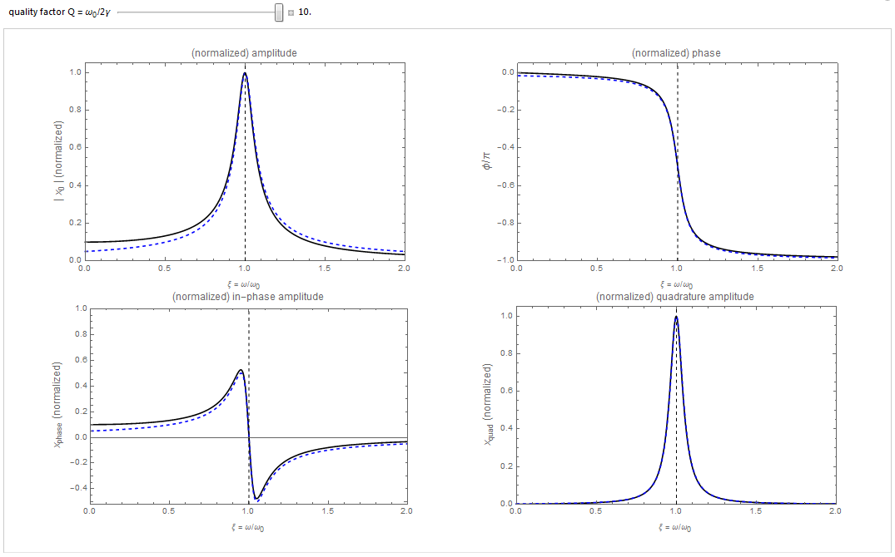
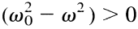
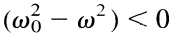
Unit 2
Lorentz Oscillator Resonance
absorption
phase
in-phase
out-of-phase
(n-1)
ResonanceLineshapesOfADrivenDampedHarmonicOscillator.cdf

Slide 8
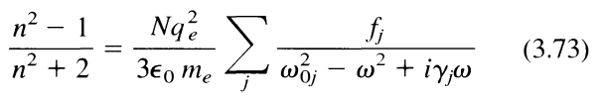
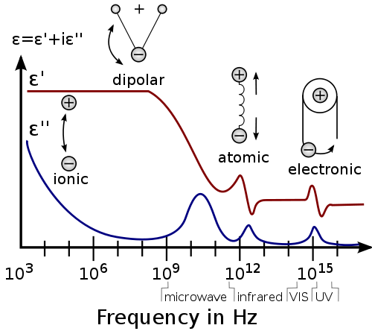
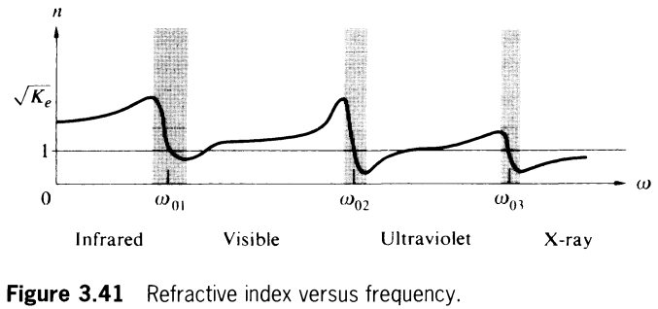
Unit 2
A material usually has multiple resonant frequencies and/or oscillator species
“anomalous” dispersion
“normal” dispersion

Slide 9
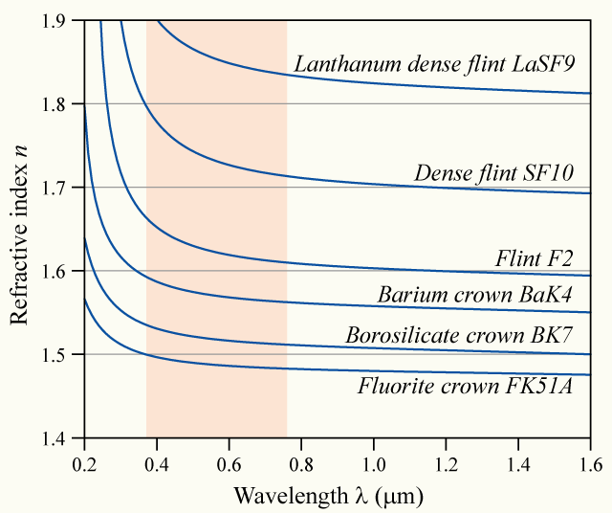
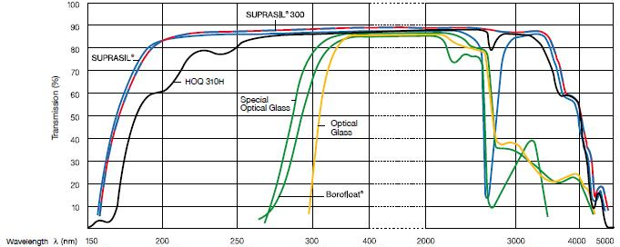
Unit 2
“Normal” Dispersion of
Different Glasses

Slide 10
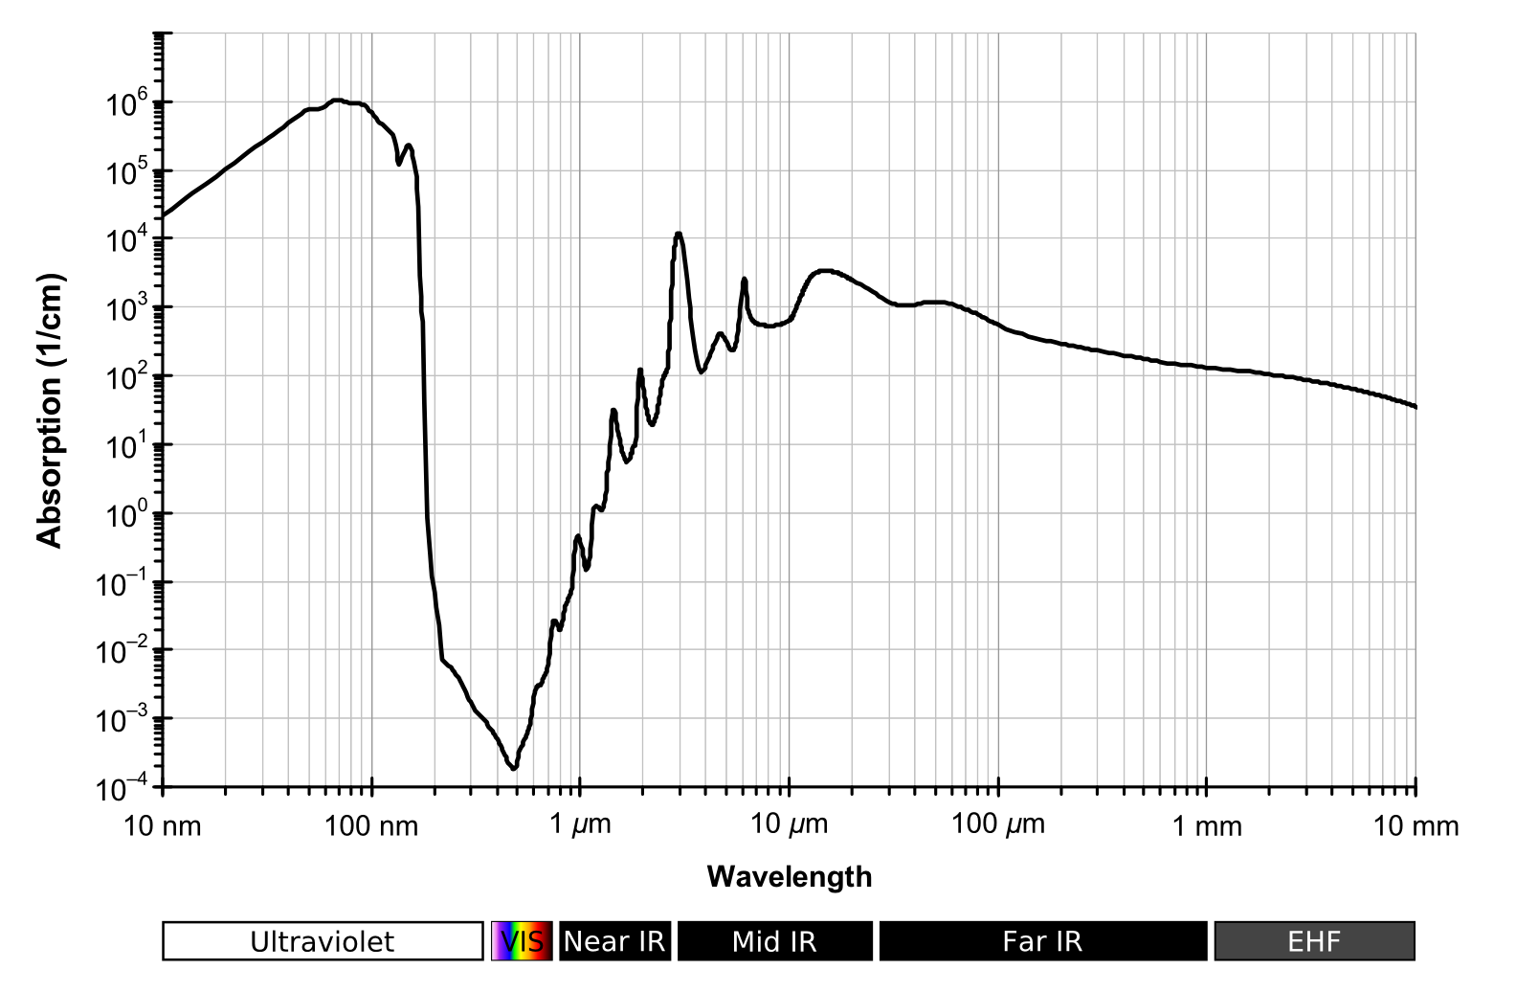
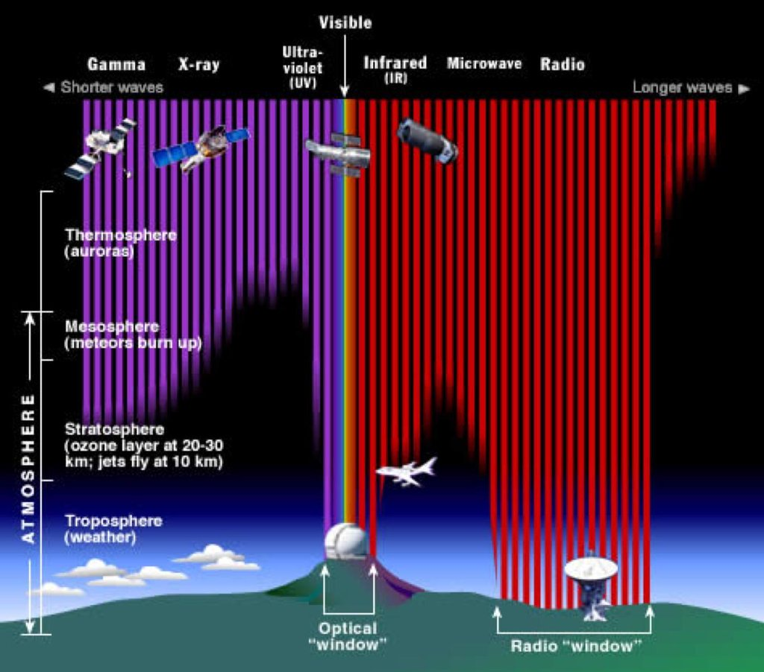
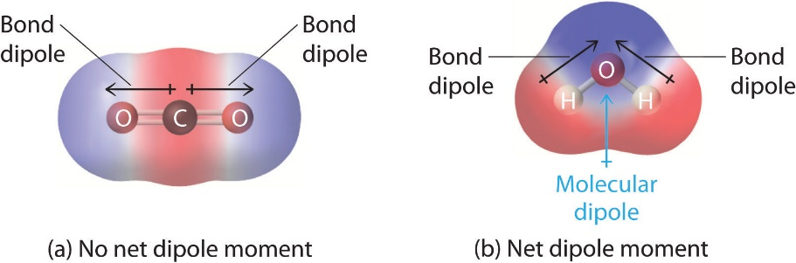
Unit 2
Absorption characteristics depend a lot on the energy level structure of the material
Water
Atmosphere

Slide 11
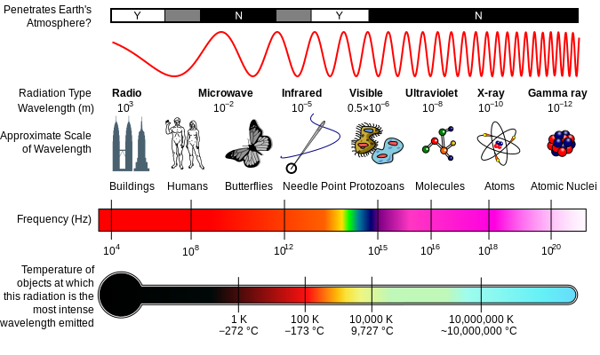
Unit 2
Interaction of light with matter depends on:
wavelength/frequency of light
polarization
atomic/molecular structure of the matter
amount of incident EM energy
Image: http://en.wikipedia.org/wiki/File:EM_Spectrum_Properties_edit.svg

Slide 12
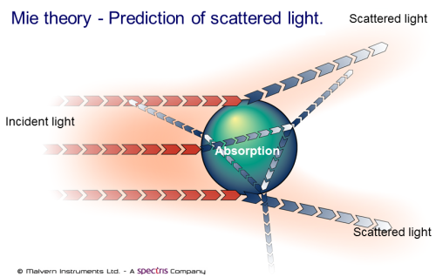
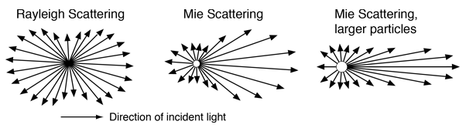
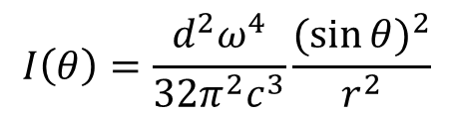
Unit 2
Optical Scattering
$$I\left(θ\right)=\frac{d^{2}ω^{4}}{32π^{2}c^{3}}\frac{{(sin{θ)}}^{2}}{r^{2}}$$
Scattering by a polarizable particle
Interference of scattered waves from many particles depends on their density compared to the wavelength
For ω<ω₀, phase of scattered wave is near 0
For ω>ω₀, phase of scattered wave is near π
hyperphysics.phy-astr.gsu.edu

Slide 13
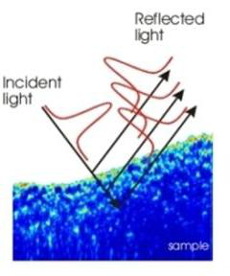
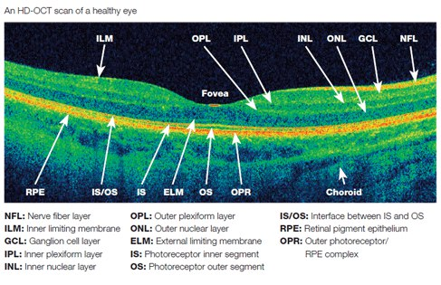
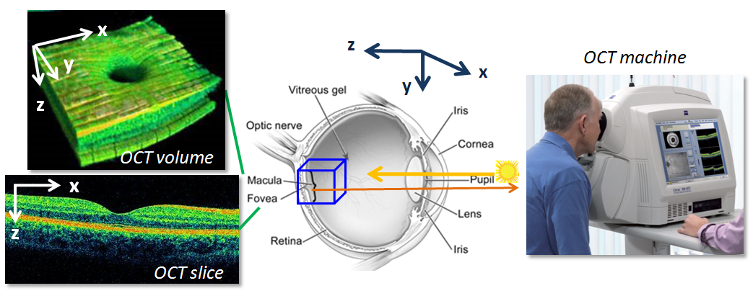
Unit 2
Optical Coherence Tomography
www.recendt.at
www.cc.gatech.edu
[see demo video: http://www.youtube.com/watch?v=pl-d8zE_Mhw]

Slide 14
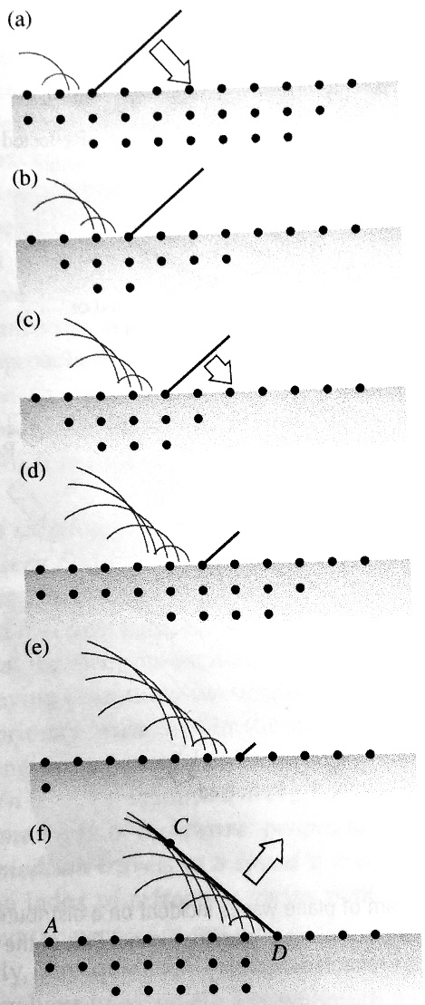
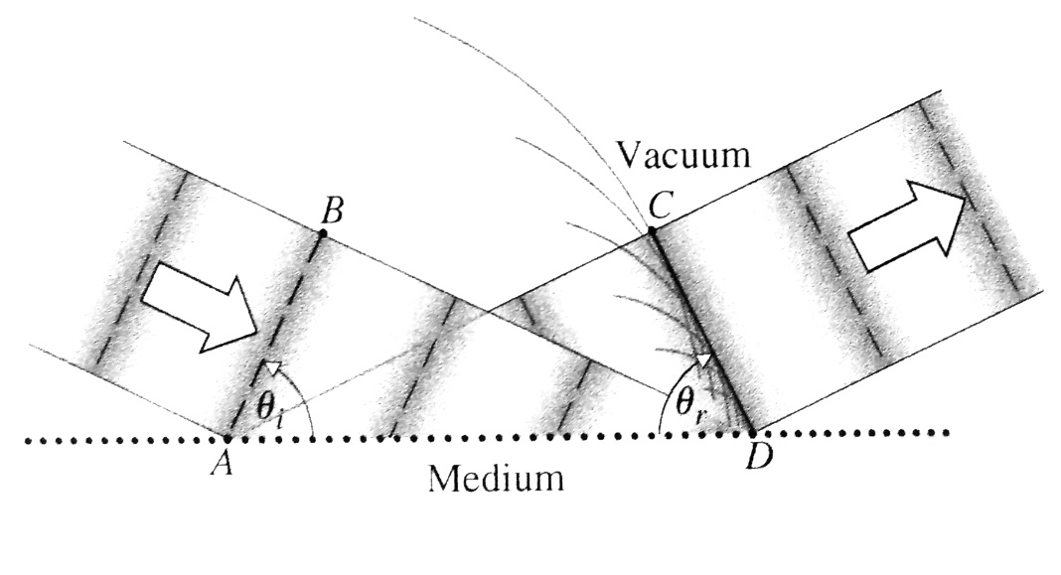
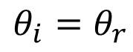
Unit 2
Reflection
Law of Reflection
$$θ_{i}=θ_{r}$$

Slide 15
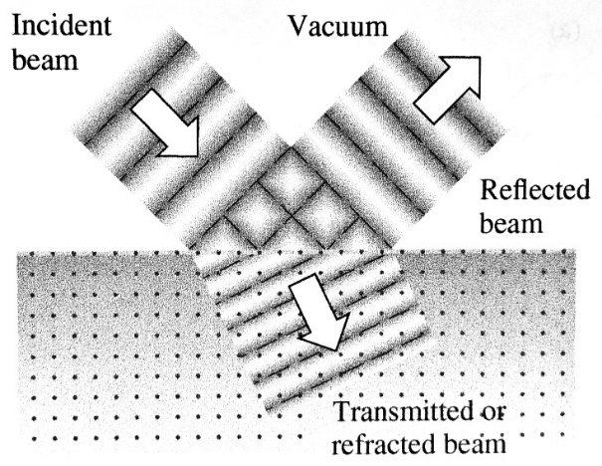
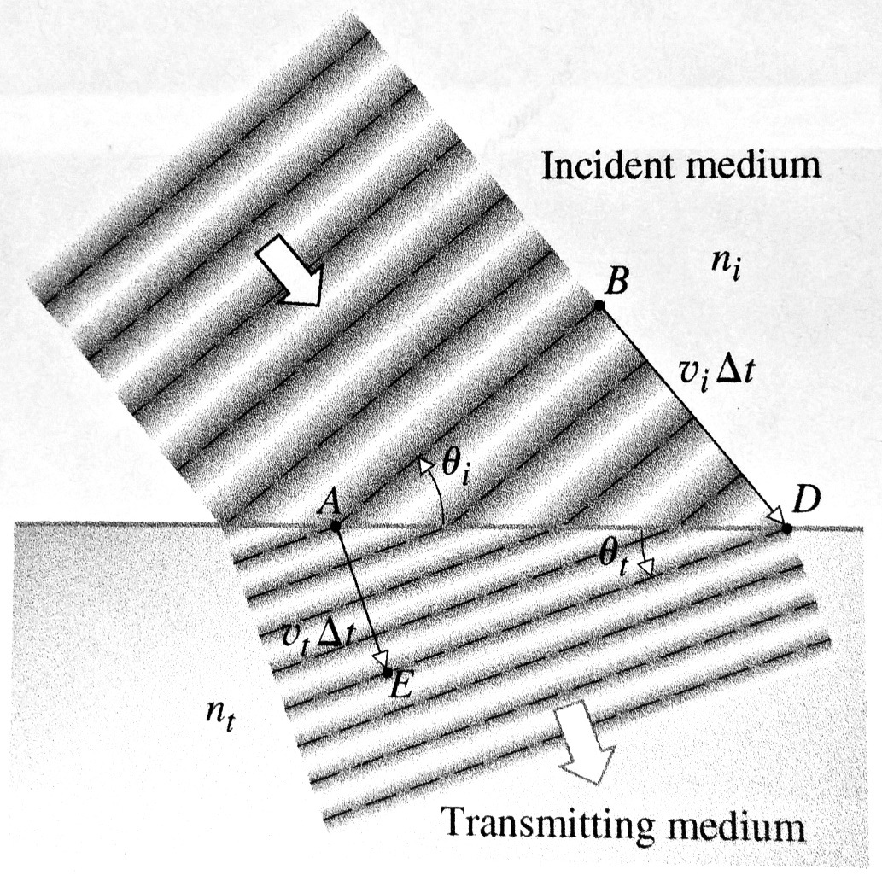
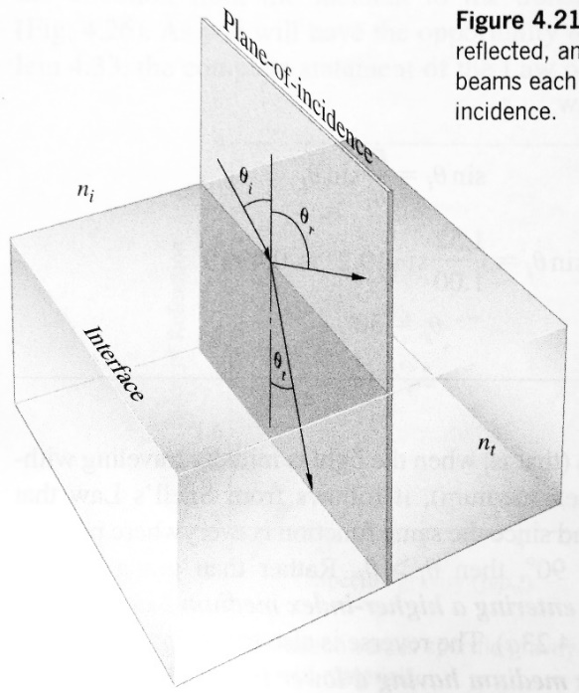
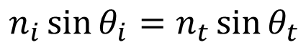
Unit 2
Refraction/Transmission
Law of Refraction (Snell’s Law)
$$n_{i}\sin{θ_{i}}=n_{t}\sin{θ_{t}}$$

Slide 16
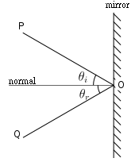
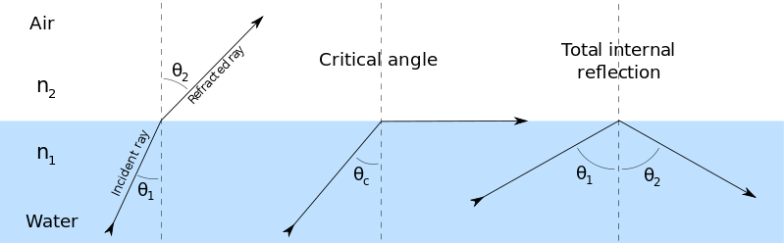

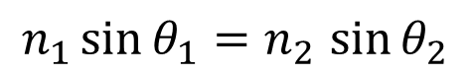
Unit 2
Reflection and Refraction
$$θ_{i}{=θ}_{r}$$
Law of Reflection
Snell’s Law
$$n_{1}\sin{θ_{1}}{=n}_{2}\sin{θ_{2}}$$
Wikipedia

Slide 17
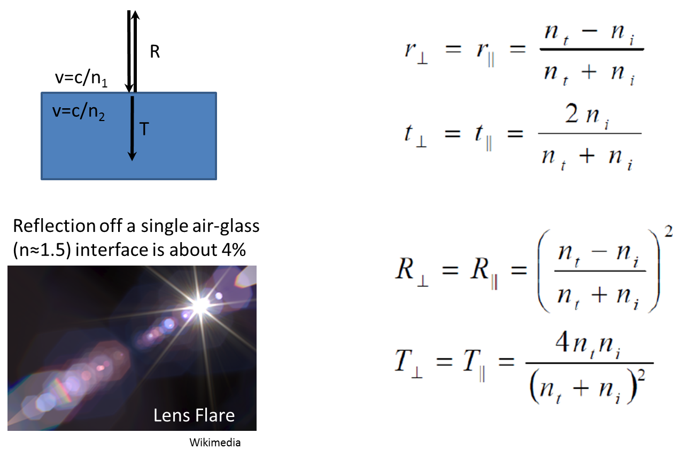
Unit 2
Reflection and Transmission at Normal Incidence

Slide 18
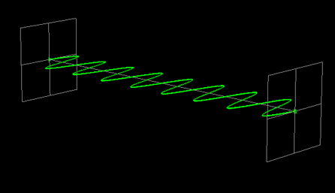
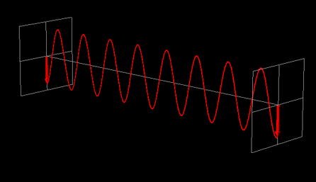
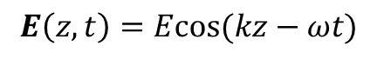
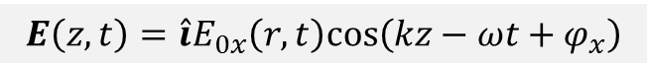
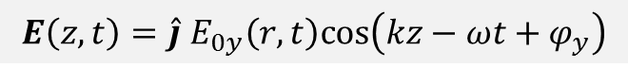
Unit 2
EM waves (light) as a vector field, not a scalar
So far, we’ve mostly been considering waves like:
$$E\left(z,t\right)=Ecos(kz−ωt)$$
We need to think about the more general case where the fields are vectors:
$$E\left(z,t\right)=\hat{i}E_{0x}\left(r,t\right)cos\left(kz−ωt+φ_{x}\right)$$
$$E\left(z,t\right)={\hat{j} E}_{0y}\left(r,t\right)cos\left(kz−ωt+φ_{y}\right)$$
image credit: www.photophysics.com

Slide 19
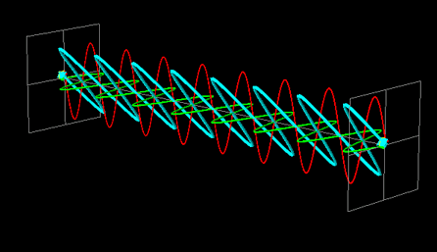
Unit 2
Arbitrary Polarization with Superposition
$$E\left(z,t\right)=\hat{i}E_{0x}\left(r,t\right) cos\left(kz−ωt+φ_{x}\right)+{\hat{j} E}_{0y}\left(r,t\right) cos\left(kz−ωt+φ_{y}\right)$$

Slide 20



Unit 2
Circular Polarization
$$E\left(z,t\right)=\hat{i}E_{0x}\left(r,t\right)cos\left(kz−ωt+φ_{x}\right)+{\hat{j} E}_{0y}\left(r,t\right)cos\left(kz−ωt+φ_{y}\right)$$
if $E_{0x}=E_{0y}=E_{0}$and $φ_{x}=φ_{y}+2mπ$ the two vector components are
90 degrees out of phase, and we can write the resultant wave as:
$$E\left(z,t\right)=E_{0} \left( \hat{i}cos\left(kz−ωt\right)±\hat{j} sin\left(kz−ωt\right) \right)$$
The electric field vector has a constant magnitude, but is rotating!
Left-circular
Right-circular
Counter- clockwise
Clockwise
[more about this in Unit 5]

Slide 21


Unit 2
Dielectric Interfaces
Given incident wave amplitude, direction, polarization,
for the reflected and transmitted beams we can calculate:
direction of propagation
field amplitudes (or power, if desired)
P
S
There are some surprises hiding in the details…
What about the phase of the light after reflection/transmission?
What happens to the transmitted light when the incident angle exceeds the critical angle?
Evanescent Waves
Clarification: Waveguide nomenclature for field orientation
Transverse Magnetic: TM
P-polarized
E^{(p)} = E//
Transverse Electric: TE
S-polarized
E^{(s)} = E$⊥$

Slide 22

Unit 2
The Fresnel Equations
These are electric field amplitude coefficients

Slide 23

Unit 2
The Fresnel Equations
These expressions can be written in a variety of ways, each one useful under different circumstances
[Note: The angles are not independent of each other and are constrained by Snell’s law]

Slide 24







Unit 2
The Fresnel Equations (amplitude coefficients)
n_{i} < n_{t}
n_{i} > n_{t}
0
0
0
$$θi$$
$$π/2$$
0
$$θi$$
$$π/2$$

Slide 25

Unit 2
Brewster’s Angle
Dipoles cannot emit into the direction of their oscillation

Slide 26


Unit 2
The Fresnel Equations (power coefficients)
n_{i} < n_{t}
n_{i} > n_{t}
||
||

Slide 27

Unit 2
The Fresnel Equations (can play around with these in a Mathematica widget)

Slide 28
Unit 2
Phase Shifts at Interfaces (normal incidence)
Transmitted light:
Δφ = 0⁰
Reflected light:
If n₁ < n₂ then Δφ = 180⁰
If n₁ > n₂ then Δφ = 0⁰

Slide 29
Unit 2
Phase Shifts at Interfaces (arbitrary incidence)
Transmitted light:
Δφ = 0⁰ unless n₁ > n₂ and θ₁ > θ_{crit} (glass to air, TIR)
In which case 0 < Δφ < 90⁰, and depends on polarization and angle
Reflected light:
If n₁ < n₂ then Δφ = 180⁰ ( s-polarized flips to 0⁰ for θ₁ > θ_{brewster})
If n₁ > n₂ then Δφ = 0⁰ ( s-polarized flips to 180⁰ for θ₁ > θ_{brewster})
If n₁ > n₂ and θ₁ > θ_{crit} (glass to air, TIR) then 0 < Δφ < 180⁰, and depends on both polarization and angle

Slide 30




Unit 2
Total Internal Reflection
Exponentially decaying
“evanescent” field:
$$E∝e^{ik_{R}x}e^{−k_{I}y}$$
$$y$$
$$x$$
Interference of incident
and reflected waves
Image Credit: http://perso.univ-lemans.fr/~cpotel

Slide 31


Unit 2
Evanescent Waves
Beyond the critical angle, $k_{t}$ is imaginary
Exponentially decaying field: E ~ e^{-kx}
Still time-dependent: moves along interface
What if we bring in another glass surface?
Photon tunneling!
Just like a quantum particle tunneling through a classically forbidden barrier.

Slide 32






Unit 2
Evanescent Wave Applications
optical ring resonators
total internal reflection microscope
T. J. Kippenberg, Nature 482, 63 (2012)

Slide 33




Unit 2
Plasma Frequency
$$ω_{p}^{2}=\frac{{Nq}^{2}}{mε_{0}}$$
“Collective” oscillation frequency for free electrons
not the same as the dipole resonant frequency ω₀
Example: in the ionosphere, ω_{p}/2π ≈ 9 MHz,
important for long-range radio communications!
The polarization of a conductor depends on the plasma frequency and the dipole oscillation frequency
*You might not want to compute these by hand…
= n_{t} is complex (here, n_{i} = 1)

Slide 34




Unit 2
Reflection by a good conductor
Air-silver interface at normal incidence, 780 nm light
n_{Ag} = 0.27 + 4.47i
Gives a reflectivity of about 95%, which is pretty good.
How far does the wave penetrate?
Calculate the skin depth:
Credit: D. Steck

Slide 35
Unit 2

